Slide 1
ONLINE BOOK SHOP
- D. Gopilingam,
II M.Sc. Computer Science,
Kamaraj College.

Slide 2
Abstract
The main objective of the project is to create an online book shop that allows users to search and purchase a book online based on title, author and subject. The selected books are displayed in a tabular format and the user can order their books online through credit card payment. Using this Website the user can purchase a book online instead of going out to a book store and wasting time. There are many online book stores like Amazon, Flipkart. I want to develop a similar website using Python Django Framework.
Online Book store is an online web application where the customer can purchase books online. Through a web browser the customers can search for a book by its title or author, later can add to the shopping cart and finally purchase using credit card transaction. The user can login using his account details or new customers can set up an account very quickly. They should give the details of their name, contact number and shipping address. The user can also give feedback to a book by giving ratings on a score of five. The books are divided into many categories based on subject like Software, Database, English, Architecture etc.

Slide 3
The Online Book Shop Website provides customers with online shopping through a web browser. A customer can, create, sign in to his account, place items into a shopping cart and purchase using his credit card details.
The Administrator will have additional functionalities when compared to the common user. He can add, delete and update the book details, book categories, member information and also confirm a placed order.

Slide 4
System Analysis and Design
In the process of evaluating the solution and the specifications of a detailed on-line based solution, there is need for the system design. In designing the new system, the software and hardware aspects were taken into considerations in order to produce a workable website that will allow effective and efficient communication between the customer, the merchant and the acquiring bank or acquirer.
Also the customer can make an order, make payments for the goods ordered, and the goods/books will be shipped to him/her.

Slide 5
Requirements
Here we are including the software and hardware used for developing the project and implementing the project.

Slide 6
Software Requirements
1. PYTHON, HTML, CSS, BOOTSTRAP,
SQLITE3
2. Web Browser: Google Chrome

Slide 7
Hardware Requirements
1. System: Intel Core i3 Processor
2. Hard Disk: 500 GB
3. Monitor: Standard LED Monitor
4. Input: Keyboard
5. Ram: 4GB

Slide 8
Modules
1. Home Page
2. search
3. cart
4. order
5. Store

Slide 9
Admin Features
1. Dash Board
2. Manage Books
3. Manage categories
4. Manage orders
5. manage user
6. Login and Layout

Slide 10
Customer Features
1. Login Page
2. Register Page
3. Home Page
4. Book View Page
5. Cart List Page
6. My Order Page
7. Cash and Credit Card Payments

Slide 11
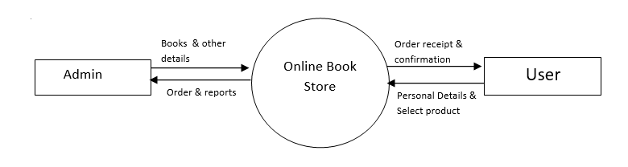
DATA FLOW DIAGRAM

Slide 12
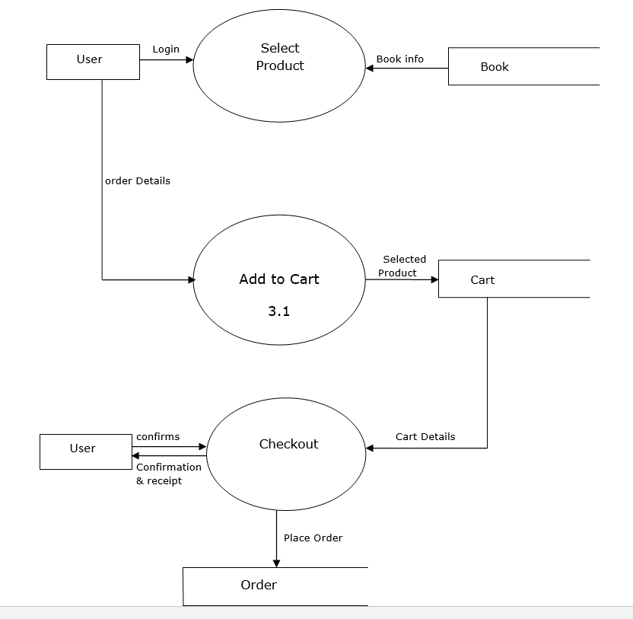

Slide 13
RESEARCH METHODOLOGY
The main method of research concerning this project is by observation and interview with the bookshop chairman. After frequent visits to the bookshop, it was easy to draw out conclusions from some observation about the current system. Brief interviews with some students who agreed having an idea of the bookshop were also of great help to this project.

